Slide 1
Team 4 – Awesome Project The Beer Hunters Ultimate Search Tool
Team Members:
Marcelino Esparza
Aldo Solano
Sergio Rodríguez
Fredrik NIlsson

Slide 2
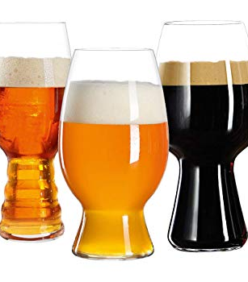
Project description
Identify beer & dining options in current or selected location, being aware of climate conditions

Slide 3
Motivation
For travelers, sometimes it is hard to know beer and dining options on places to visit
Considering the vast variety of commercial and craft beers, it is difficult to have access to detailed information of available beers in a specific location
Being prepared for weather condition is always important

Slide 4
Team Effort
Sergio: Research on the beer API, and integrating the API’s to the the Java, Java problems resolution.
Marce: Weather and restaurant API’s
Aldo: Web page design and main front integration of all components
Fred: Drop-down menu research and rules, GitHub administration, Events API research (discarded)

Slide 5
Lessons learned
Have a Project Leader!!!! All of us where doing research and work and we thought we were integrated, but we did not have a specific goal. We learned too late that we were not on Schedule and that we were not working towards the same objective.
Have defined sub-objectives
Plan for daily meetings
Understand how easy/hard it is to obtain an API Key before spending hours researching on the API
Read all the documentation (we had a major CORS issue)

Slide 6

Differente technologies
GetJson to solve Cross Origin Resource Sharing
Integrating drop down menus filtering only the admitted options

